Slide 1
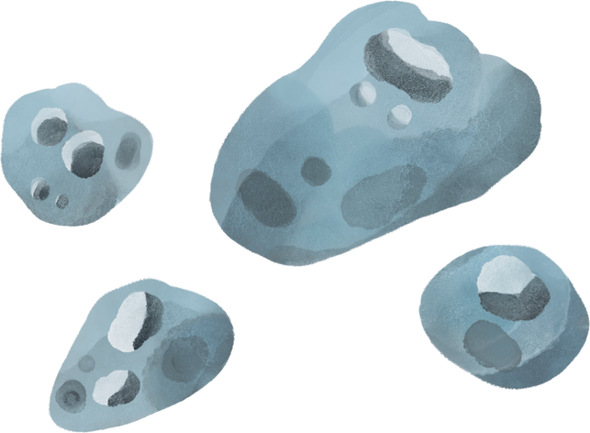

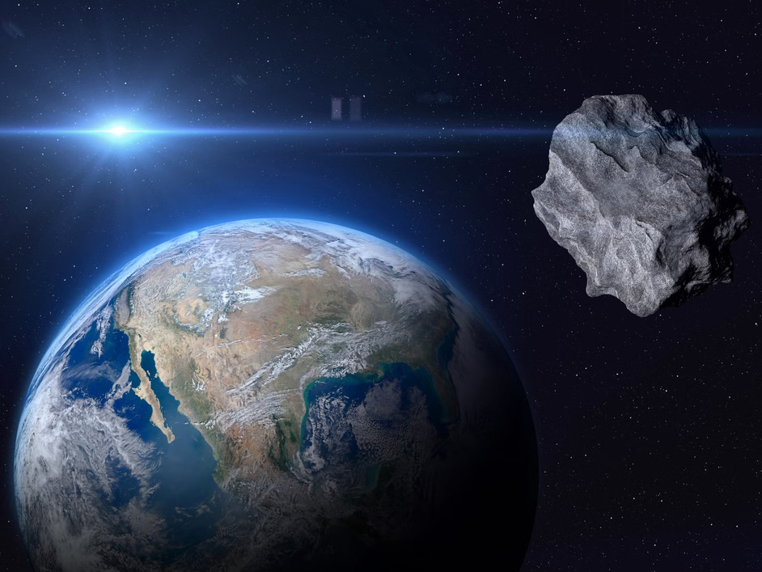

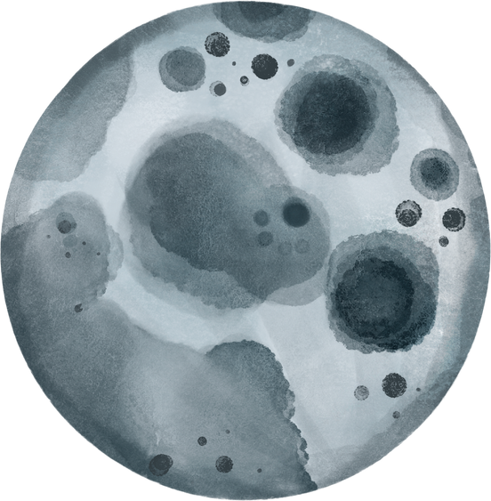

CI PROJECT
IDENTIFYING POTENTIALLY HAZARDOUS ASTEROIDS

Slide 2



TEAM MEMBERS
Suryansh Ambekar (202201090042)
Mayank Soni (202201090031)
Aayush Tank (202201070139)
Sneha Kurhade (202201070137)
GUIDED BY:
DR. SMITA KULKARNI
MRS. ASWATHY M. A.
DR. NUTAN BANSODE

Slide 3

MOTIVATION
TECH OPPORTUNITY
Machine learning for asteroid classification.
ASTRONOMICAL SOLUTIONS
REAL-TIME ASTEROID MONITORING SYSTEMS.
SPACE SAFETY
Early detection ensures planetary defense.
GLOBAL IMPACT
INNOVATION
ADVANCE TECHNOLOGY FOR PLANETARY DEFENSE STRATEGY.
ENHANCE INTERNATIONAL SPACE SAFETY PREPAREDNESS.

Slide 4

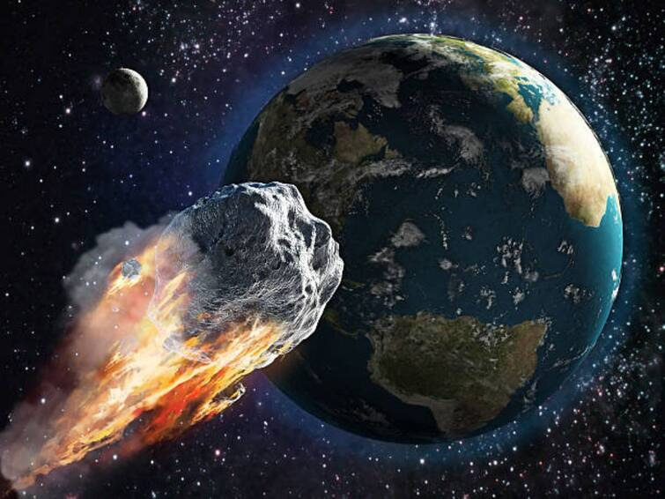

AIM OF THE PROJECT
To develop a machine learning model that classifies asteroids as hazardous or non-hazardous based on features like size, speed, and trajectory.
Integrate MLOps for seamless real-time deployment and monitoring.
Enhance space safety.

Slide 5

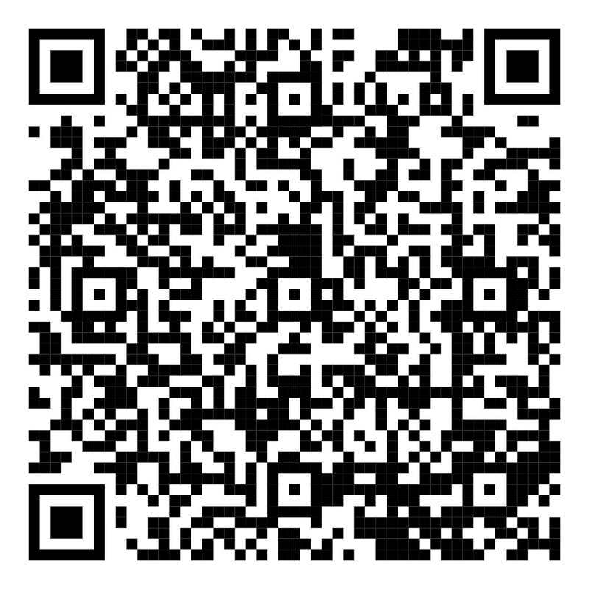
DATASET
AND METHODOLOGY
Data preprocessing and feature selection.
Multiple Model training on same dataset.
Finalising the most appropriate model.
Integration of ML Ops for deployment.
OUTCOME:
A user friendly GUI to interact with ML model.
DATA FROM NASA'S NEOWS
(Near Earth Object Web Service)

Slide 6

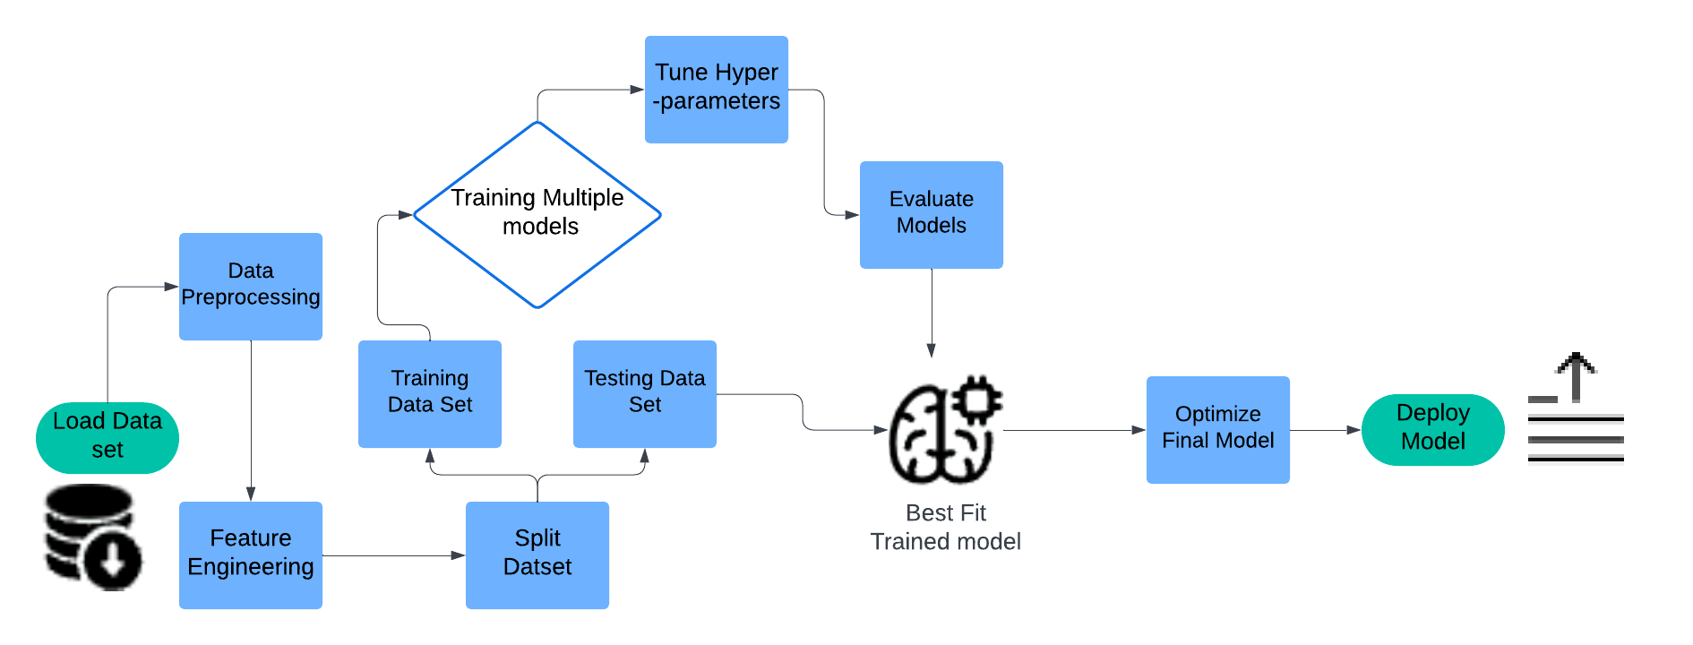
FLOWCHART

Slide 7
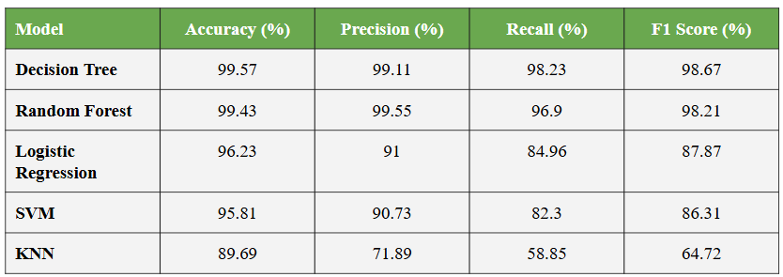

RESULTS

Slide 8
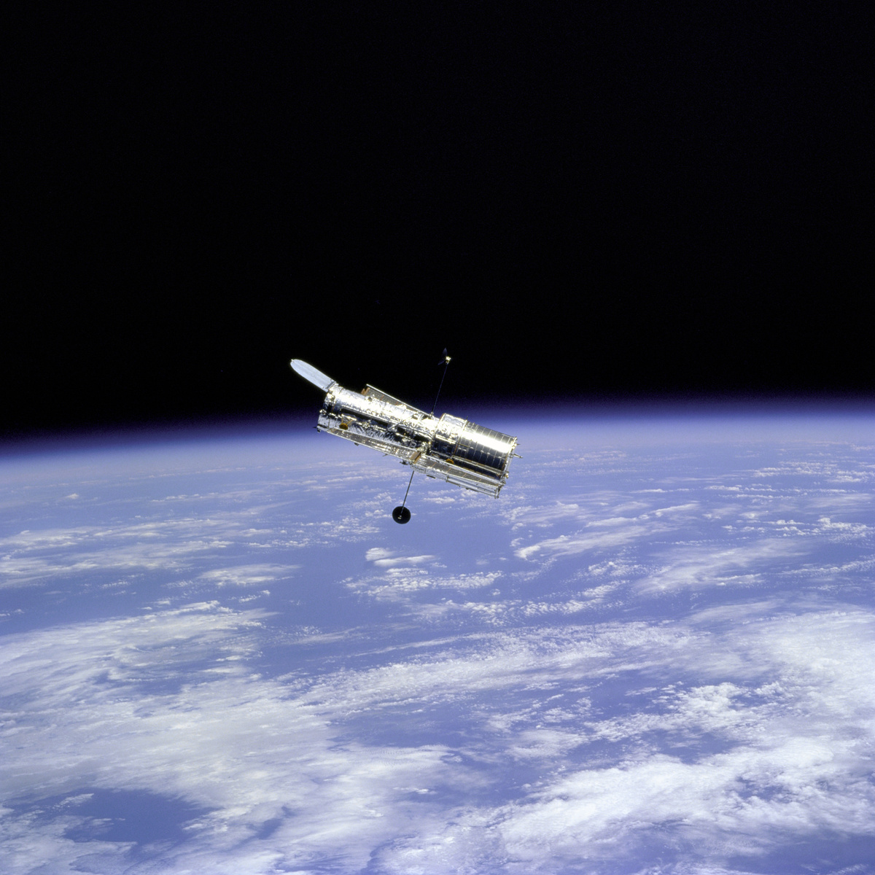


CI/CD PIPELINES
CI Pipeline:
Code commit → Automated testing → Model training → Validation → Versioning
CD Pipeline:
Fetch trained models → Build API → Deploy to production → Monitor performance

Slide 9
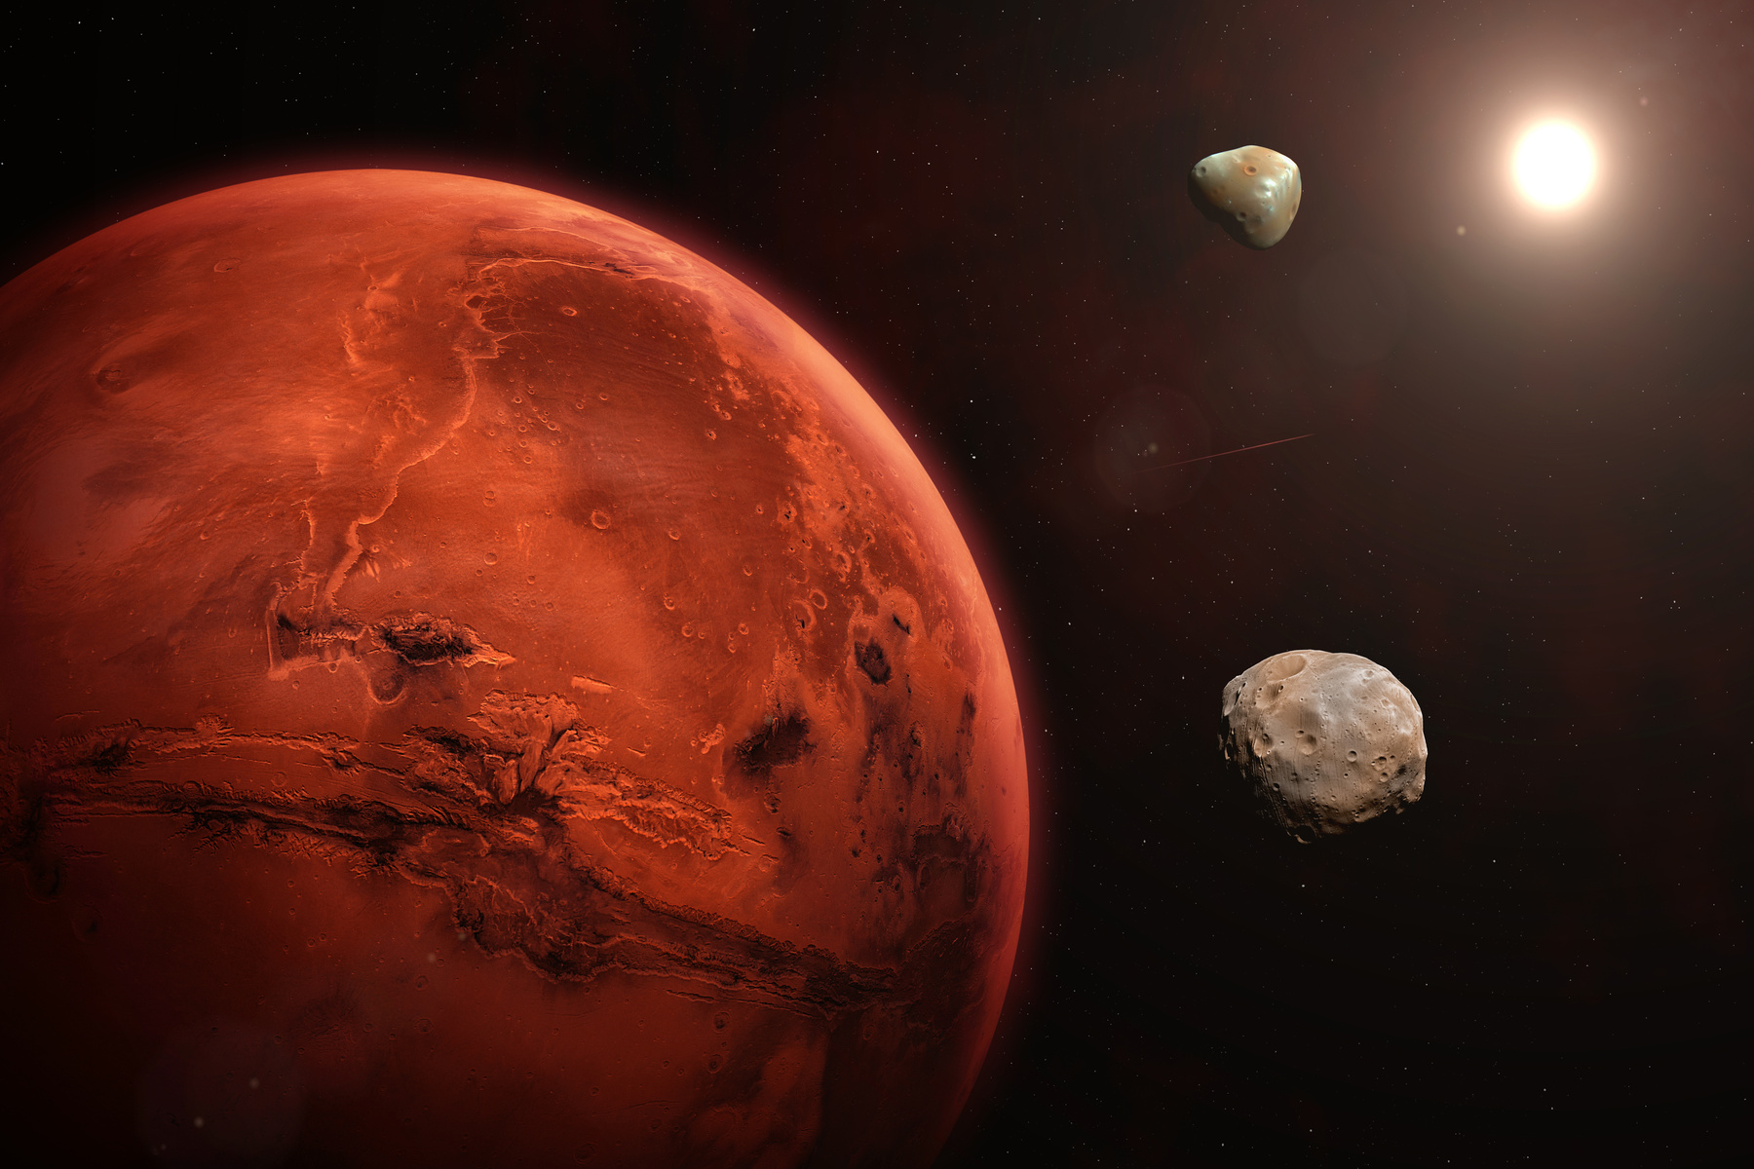
CONCLUSION AND SCOPE
The project successfully classified asteroids with high accuracy and identified critical hazard factors.
Real-time monitoring enhanced space safety measures.
Future Work:
Incorporating additional datasets for improved prediction.
Refining the model for better scalability.

Slide 10
CONCLUDING REMARKS AND QUESTIONS

